Slide 1
SIMATIC S7-1500 hardware migration support
SIMATIC Innovation – Status 01/2016 (FW 1.8 ff.)

Slide 2
SIMATIC Innovation Important advices
We do not accept any liability for the information contained in this document.
Any claims against us – based on whatever legal reason – resulting from the use of the examples, information, programs, engineering and performance data etc., described in this document shall be excluded. Such an exclusion shall not apply in the case of mandatory liability, e.g. under the German Product Liability Act (“Produkthaftungsgesetz”), in case of intent, gross negligence, or injury of life, body or health, guarantee for the quality of a product, fraudulent concealment of a deficiency or breach of a condition which goes to the root of the contract (“wesentliche Vertragspflichten”). The damages for a breach of a substantial contractual obligation are, however, limited to the foreseeable damage, typical for the type of contract, except in the event of intent or gross negligence or injury to life, body or health. The above provisions do not imply a change of the burden of proof to your detriment.

Slide 3
SIMATIC Innovation Big Picture: S7-300/400 → S7-1500 in discrete automation (factory automation)
CPU 417-4
CPU 416F-3 PN/DP
CPU 416-3 PN/DP
CPU 416-3
14 CPUs S7-1500
CPU 1518F-4 PN/DP
CPU 1518-4 PN/DP
CPU 1517F-3 PN/DP
CPU 1517-3 PN/DP
CPU 1516F-3 PN/DP
CPU 1516-3 PN/DP
CPU 1515F-2 PN
CPU 1515-2 PN
CPU 1513F-1 PN
CPU 1513-1 PN
CPU 1512C-1 PN
CPU 1511C-1 PN
CPU 1511F-1 PN
CPU 1511-1 PN
CPU 416F-2
CPU 416-2
CPU 414F-3 PN/DP
CPU 414-3 PN/DP
CPU 414-3
CPU 414-2
CPU 412-2 PN/DP
CPU 412-2
CPU 412-1
19 CPUs S7-300
CPU 319F-3 PN/DP
CPU 319-3 PN/DP
CPU 317F-2 PN/DP
CPU 317-2 PN/DP
CPU 317F-2 DP
CPU 317-2 DP
CPU 315F-2 PN/DP
CPU 315-2 PN/DP
CPU 315F-2 DP
CPU 315-2 DP
CPU 314C-2 PN/DP
CPU 314C-2 DP
CPU 314C-2 PtP
CPU 314
CPU 313C-2 DP
CPU 313C-2 PtP
CPU 313C
CPU 312C
CPU 312
9 CPUs S7-400
Portfolio reduction & all standard CPUs are also available as failsafe!

Slide 4

SIMATIC Innovation Advanced Controller SIMATIC S7-1500: Standard, Compact and Failsafe Portfolio
PROFIBUS
CPU 1511
CPU 1511F
CPU 1511C
CPU 1512C
CPU 1513
CPU 1513F
CPU 1515
CPU 1515F
CPU 1516
CPU 1516F
CPU 1517
CPU 1517F
CPU 1518
CPU 1518F
PROFINET / IE
CPU Type
1511(F)-1 PN
1511C-1 PN
1512C-1 PN
1513(F)-1 PN
1515(F)-2 PN
1516(F)-3 PN/DP
1517(F)-3 PN/DP
1518(F)-4 PN/DP
Interface
1
1
1
1
1
2
1
2
1
2
1
2
1
1
1
1
1
1
1
1
3
Program / Data memory
150 (225) KB 1 MB
175 KB 1 MB
250 KB 1 MB
300 (450) KB 1.5 MB
500 (750) KB 3 MB
1 (1.5) MB 5 MB
2 (3) MB 8 MB
4 (6) MB 20 MB
Bit performance
60 ns
60 ns
48 ns
40 ns
30 ns
10 ns
2 ns
1 ns
# Axis
up to 6
up to 6
up to 6
up to 6
up to 30
up to 30
up to 96
up to 128
Width
35 mm
85 mm
110 mm
35 mm
70 mm
70 mm
175 mm
175 mm
Simple CPU selection thanks to optimized portfolio

Slide 5

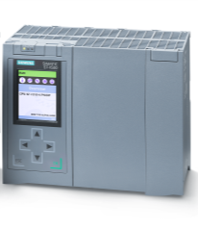
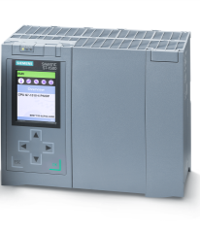
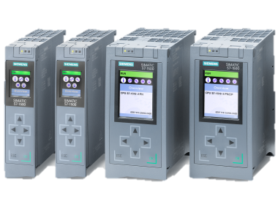
SIMATIC Innovation Standard CPU Portfolio S7-1500 is complete (TIA Portal V13 SP1 / FW V1.8)
S7-1500 CPU Portfolio
CPU 1511-1 PN … CPU 1518-3 PN/DP
1518
1517
416-2
319-3 PN/DP
414-3 PN/DP
1516
317-2 PN/DP
414-3
7-3
7-3
317-2 DP
414-2
1515
315-2 PN/DP
412-2 PN/DP
1513
315-2 DP
412-2
1511
314
412-1
312
German list price in €, regional adjustment may differ!
1,000
2,000
3,000
4,000
5,000
6,000
7,000
S7-1500
Notes:
5

Slide 6
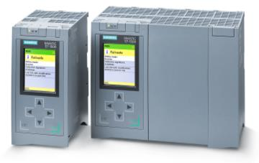
SIMATIC Innovation Failsafe CPU Portfolio S7-1500 is complete (TIA Portal V13 SP1 / FW V1.8)
CPU 1511F-1 PN … CPU 1518F-3 PN/DP
S7-1500F CPU Portfolio
1518F
1517F
416F-2
319F-3 PN/DP
414F-3 PN/DP
1516F
317F-2 PN/DP
317F-2 DP
1515F
315F-2 PN/DP
1513F
315F-2 DP
1511F
German list price in €, regional adjustment may differ!
1,000
2,000
3,000
4,000
5,000
6,000
7,000
S7-1500
Notes:
6

Slide 7
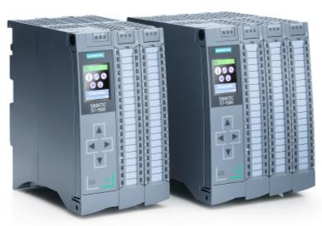
SIMATIC Innovation Compact CPU Portfolio S7-1500 is complete (TIA Portal V13 SP1 / FW V1.8)
SIMATIC CPU 1511C-1 PN / 1512C-1 PN
S7-1500C CPU Portfolio
Notes:
S7-300C incl. IO connector (Push-In)
CPU 313C has more IOs than CPU 1511C
1512C
314C-2 PN/DP
314C-2 DP
314C-2 PtP
1511C
313C-2 DP
313C-2 PtP
313C
312C
S7-1500
German list price in €, regional adjustment may differ!
500
1,000
1,500
Notes:
7

Slide 8
SIMATIC Innovation Migration to SIMATIC S7-1500 CPU 1511(F)-1 PN
S7-300
S7-1500
CPU Type
312
314
1511-1 PN
1511F-1 PN
Interfaces
1
1
1
1
Program / Data memory
150 KB 1 MB
225 KB 1 MB
32 KB
128 KB
Bit-Performance
60 ns
100 ns
60 ns
60 ns
Width
35mm
40 mm
40 mm
35mm
PROFIBUS/MPI
IF Module
PROFIBUS
MPI
PROFINET / IE

Slide 9
SIMATIC Innovation Migration to SIMATIC S7-1500 CPU 1513(F)-1 PN
S7-300
S7-400
S7-1500
CPU Type
315-2 DP
315F-2 DP
412-1
412-2
412-2PN
1513-1PN
1513F-1 PN
Interfaces
1
1
1
1
Program / Data memory
144 KB 144 KB
256 KB 256 KB
512 KB 512 KB
300 KB 1.5 MB
450 KB 1.5 MB
256 KB
384 KB
Bit-Performance
50 ns
75 ns
75 ns
31.25 ns
50 ns
40 ns
40 ns
Width
40 mm
25 mm
25 mm
25 mm
40 mm
35mm
35mm
PROFIBUS/MPI
IF Module
PROFIBUS
MPI
PROFINET / IE

Slide 10
SIMATIC Innovation Migration to SIMATIC S7-1500 CPU 1515(F)-2 PN
S7-300
S7-400
S7-1500
CPU Type
315-2 PN/DP
315F-2 PN/DP
412-1
412-2
412-2PN
1515-2PN
1515F-2 PN
Interfaces
1
2
1
2
1
1
Program / Data memory
144 KB 144 KB
256 KB 256 KB
512 KB 512 KB
500 KB 3 MB
750 KB 3 MB
384 KB
512 KB
Bit-Performance
50 ns
50 ns
75 ns
75 ns
31.25 ns
30 ns
30 ns
Width
40 mm
25 mm
25 mm
25 mm
40 mm
70mm
70mm
PROFIBUS/MPI
IF Module
PROFIBUS
MPI
PROFINET / IE

Slide 11
SIMATIC Innovation Migration to SIMATIC S7-1500 CPU 1516(F)-3 PN/DP
S7-300
S7-400
S7-1500
CPU Type
317F-2 DP
317F-2 PN/DP
412-2PN
414-2
1516-3 PN/DP
1516F-3 PN/DP
317-2 DP
317-2 PN/DP
Interfaces
1
1
1
2
1
2
1
1
1
1
Program / Data memory
512 KB 512 KB
512 KB 512 KB
1 MB 5 MB
1,5 MB 5 MB
1 MB
1.5 MB
1 MB
1.5 MB
Bit-Performance
25 ns
31.25 ns
45 ns
10 ns
10 ns
25 ns
25 ns
25 ns
Width
40 mm
70mm
40 mm
40 mm
40 mm
25 mm
25 mm
70mm
PROFIBUS/MPI
IF Module
PROFIBUS
MPI
PROFINET / IE

Slide 12
SIMATIC Innovation Migration to SIMATIC S7-1500 CPU 1517(F)-3 PN/DP
Selective Marketing: Please contact local promoter/technical consultant for verification!
S7-300
S7-400
S7-1500
CPU Type
319F-3 PN/DP
319-3 PN/DP
414-2
414-3
1517-3 PN/DP
1517F-3 PN/DP
Interfaces
1
1
1
2
1
2
2
2
1
1
Program / Data memory
512 KB 512 KB
1.4 MB 1.4 MB
2 MB 8 MB
3 MB 8 MB
2 MB
2.5 MB
Bit-Performance
4 ns
4 ns
45 ns
45 ns
2 ns
2 ns
Width
120 mm
120 mm
25 mm
50 mm
175 mm
175 mm
PROFIBUS/MPI
IF Module
PROFIBUS
MPI
PROFINET / IE

Slide 13
SIMATIC Innovation Migration to SIMATIC S7-1500 CPU 1518(F)-4 PN/DP
Selective Marketing: Please contact local promoter/technical consultant for verification!
S7-400
S7-1500
CPU Type
414-3 PN/DP
414F-3 PN/DP
416-2
416F-2
1518-4 PN/DP
1518F-4 PN/DP
Interfaces
1
2
1
2
1
3
1
3
Program / Data memory
2 MB 2 MB
4 MB 20 MB
6 MB 20 MB
2 MB 2 MB
2.8 MB 2.8 MB
2.8 MB 2.8 MB
Bit-Performance
18.75 ns
30 ns
1 ns
1 ns
18.75 ns
30 ns
Width
50 mm
25 mm
175 mm
175 mm
50 mm
25 mm
PROFIBUS/MPI
IF Module
PROFIBUS
MPI
PROFINET / IE

Slide 14
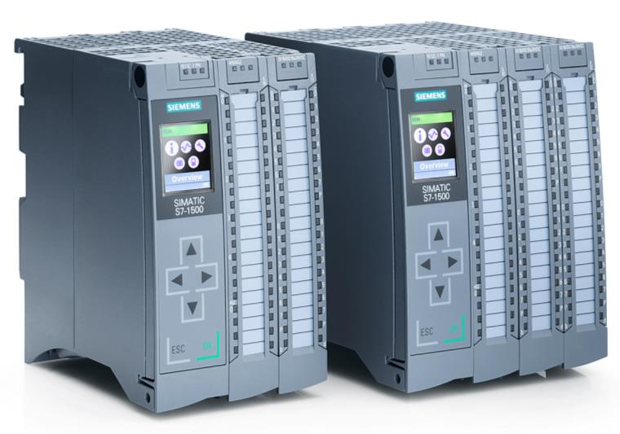
SIMATIC S7-1500 Compact CPU

Slide 15
SIMATIC Innovation Migration to SIMATIC S7-1200 CPU 1215C
S7-300 C
S7-1200 C
CPU Type
312C
1215C
Interfaces
Program/Data memory
64 KB
100 KB
Bit-Performance
100 ns
85 ns
Integrated DI/DO
10 / 6
14 / 10
Integrated AI/AO
- / -
2 / 2
HSC
2
3 + 3
PTO/PWM
- / 2
4 / 4
Width
80 mm
130 mm
PROFIBUS/MPI
IF Module
PROFIBUS
MPI
PROFINET / IE
Notes:
15

Slide 16
SIMATIC Innovation Migration to SIMATIC S7-1500 CPU 1511C-1 PN
S7-300 C
S7-1500 C
CPU Type
313C
313C-2 PtP
313C-2 DP
1511C-1 PN
Interfaces
Program/Data memory
128 KB
128 KB
128 KB
150KB/1MB
Bit-Performance
70 ns
70 ns
70 ns
60 ns
Integrated DI/DO
24 / 16
16 / 16
16 / 16
16 / 16
Integrated AI/AO
4+1 / 2
- / -
- / -
4+1 / 2
HSC
3
3
3
6
PTO/PWM
- / 3
- / 3
- / 3
4* / 4*
Width
120 mm
80 mm
80 mm
85 mm
PROFIBUS/MPI
IF Module
PROFIBUS
MPI
PROFINET / IE
* Not in the first delivery step (from FW 2.0 on)
Notes:
16

Slide 17
SIMATIC Innovation Migration to SIMATIC S7-1500 CPU 1511C-1 PN (2nd option for CPU 313C)
S7-300 C
S7-1500 C
CPU Type
313C
1511C-1 PN
16DI
Interfaces
Program/Data memory
128 KB
150KB/1MB
Bit-Performance
70 ns
60 ns
+
Integrated DI/DO
24 / 16
16 / 16
16
Integrated AI/AO
4+1 / 2
4+1 / 2
HSC
3
6
PTO/PWM
- / 3
4* / 4*
Width
120 mm
85 mm
25 mm
PROFIBUS/MPI
IF Module
PROFIBUS
MPI
PROFINET / IE
* Not in the first delivery step (from FW 2.0 on)
* Nicht in der ersten Lieferstufe
Notes:
17

Slide 18
SIMATIC Innovation Migration to SIMATIC S7-1500 CPU 1512C-1 PN
S7-300 C
S7-1500 C
CPU Type
314C- 2 PtP
314C-2 DP
314C-2 PN/DP
1512C-1 PN
Interfaces
Program/Data memory
192 KB
192 KB
192 KB
200KB/1MB
Bit-Performance
60 ns
60 ns
60 ns
48 ns
Integrated DI/DO
24 / 16
24 / 16
24 / 16
32 / 32
Integrated AI/AO
4+1 / 2
4+1 / 2
4+1 / 2
4+1 / 2
HSC
4
4
4
6
PTO/PWM
1 / 4
1 / 4
1 / 4
4* / 4*
Width
120 mm
120 mm
120 mm
110 mm
PROFIBUS/MPI
IF Module
PROFIBUS
MPI
PROFINET / IE
* Not in the first delivery step (from FW 2.0 on)
Notes:
18

Slide 19
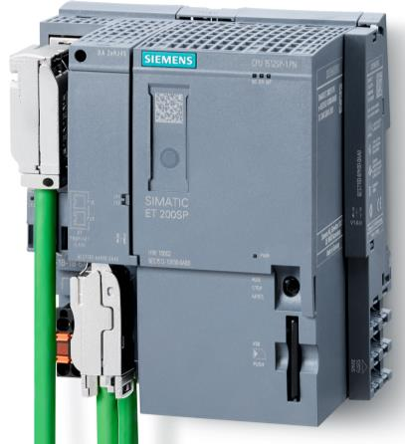
SIMATIC Innovation Distributed Controller SIMATIC ET 200SP CPU
CPU 1510SP-1 PN / CPU 1510SP F-1 PN CPU 1512SP-1 PN / CPU 1512SP F-1 PN

Slide 20
SIMATIC Innovation Migration to SIMATIC S7-1500 CPU 1510SP(F)-1 PN
ET 200S
ET 200SP
CPU Type
IM 151-7 CPU
IM 151-7F CPU
1510SP-1 PN
1510SP F-1 PN
Interfaces
1
1
1
1
1
1
Program / Data memory
100 KB 750 KB
150 KB 750 KB
128 KB
192 KB
Bit-Performance
72 ns
72 ns
60 ns
60 ns
Width
100mm
100mm
60 mm
60 mm
PROFIBUS/MPI
IF Module
PROFIBUS
MPI
PROFINET / IE

Slide 21
SIMATIC Innovation Migration to SIMATIC S7-1500 CPU 1512SP(F)-1 PN
ET 200S
ET 200SP
CPU Type
IM 151-8 PN/DN CPU
IM 151-8F PN/DP CPU
1512SP-1 PN
1512SP F-1 PN
Interfaces
1
1
1
1
1
1
1
1
1
1
1
1
Program / Data memory
200 KB 1 MB
300 KB 1 MB
192 KB
256 KB
Bit-Performance
48 ns
48 ns
60 ns
60 ns
Width
100mm
100mm
120 mm
120 mm
PROFIBUS/MPI
IF Module
PROFIBUS
MPI
PROFINET / IE

Slide 22
SIMATIC Innovation Order Information for SIMATIC S7-1500 (TIA Portal V13 SP1 / FW V1.8)
CPU Type standard/failsafe | Order Number
CPU 1511-1 PN | 6ES7511-1AK01-0AB0
CPU 1511F-1 PN | 6ES7511-1FK01-0AB0
CPU 1513-1 PN | 6ES7513-1AL01-0AB0
CPU 1513F-1 PN | 6ES7513-1FL01-0AB0
CPU 1515-2 PN | 6ES7515-2AM01-0AB0
CPU 1515F-2 PN | 6ES7515-2FM01-0AB0
CPU 1516-3 PN/DP | 6ES7516-3AN01-0AB0
CPU 1516F-3 PN/DP | 6ES7516-3FN01-0AB0
CPU 1517-3 PN/DP | 6ES7517-3AP00-0AB0
CPU 1517F-3 PN/DP | 6ES7517-3FP00-0AB0
CPU 1518-4 PN/DP | 6ES7518-4AP00-0AB0
CPU 1518F-4 PN/DP | 6ES7518-4FP00-0AB0
CPU Type compact, IO connector | Order Number
CPU 1511C-1 PN | 6ES7511-1CK00-0AB0
CPU 1512C-1 PN | 6ES7512-1CK00-0AB0
CPU Type distributed/failsafe | Order Number
CPU 1510SP-1 PN | 6ES7510-1DJ01-0AB0
CPU 1510SP F-1 PN | 6ES7510-1SJ01-0AB0
CPU 1512SP-1 PN | 6ES7512-1DK01-0AB0
CPU 1512SP F-1 PN | 6ES7512-1SK01-0AB0
Please use the TIA Selection Tool for further configuration, esp. for IO selection:
www.siemens.com/TIA-selection-tool

Slide 23
SIMATIC Innovation Order Information for SIMATIC S7-1500 accessories (FW V1.8)
SIMATIC Memory Card | Order Number
SMC 32 GB | 6ES7954-8LT02-0AA0
SMC 2 GB | 6ES7954-8LP01-0AA0
SMC 256 MB | 6ES7954-8LL02-0AA0
SMC 24 MB | 6ES7954-8LF02-0AA0
SMC 12 MB | 6ES7954-8LE02-0AA0
SMC 4 MB | 6ES7954-8LC02-0AA0
S7-1500 Labeling Sheets, DIN A4 | Order Number
35 mm, 100 lables, 10 sheets | 6ES7592-2AX00-0AA0
25 mm, 200 lables, 10 sheets | 6ES7592-1AX00-0AA0
S7-1500 Mounting Rail | Order Number
160 mm | 6ES7590-1AB60-0AA0
245 mm | 6ES7590-1AC40-0AA0
485 mm (19“) | 6ES7590-1AE80-0AA0
530 mm | 6ES7590-1AF30-0AA0
830 mm | 6ES7590-1AJ30-0AA0
2000 mm (for cutting to length by customer) | 6ES7590-1BC00-0AA0
Please use the TIA Selection Tool for further configuration, esp. for accessory selection:
www.siemens.com/TIA-selection-tool

Slide 24
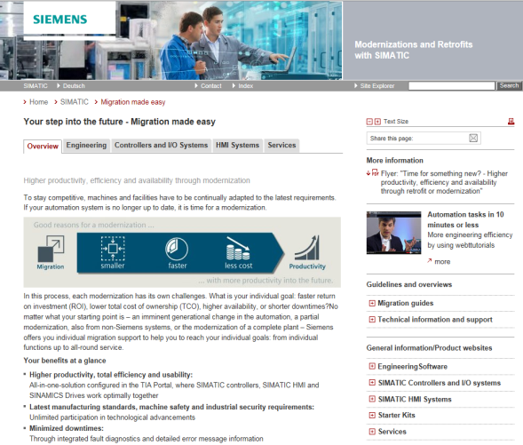
SIMATIC Innovation Further Information regarding Modernizations and Retrofits with SIMATIC
Central Internet Site with all important Links:
www.siemens.com/tia-migration
(Webtutorials, Documents, Starter Kits, Services, References)
Migration in the Industry Online Support (SIOS):
ID 83558085
Migration Guide S7-300 to S7-1500:
ID 109478811
Programming Guide and Programming Styleguide for S7-1200 and S7-1500:
ID 81318674
SIMATIC S7-1200 / S7-1500 Comparison List for Programming Languages:
ID 86630375

